Slide 1

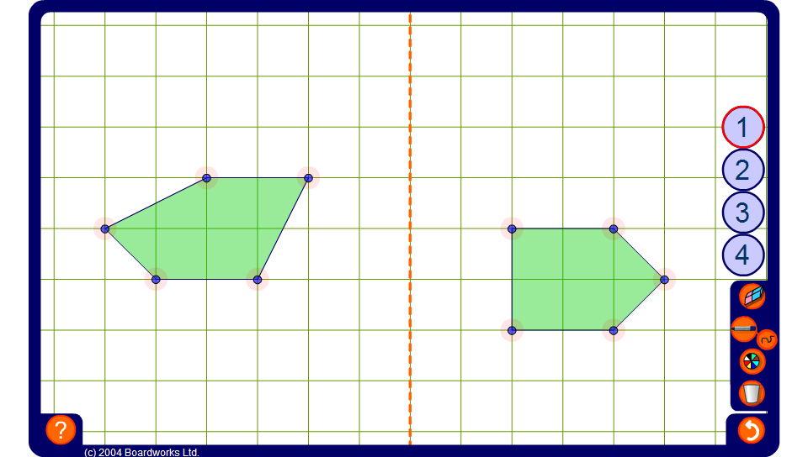


Reflect this shape
Notes:
Choose one of the buttons down the right-hand side to change the position of the mirror line. Modify one of the pentagons by dragging its vertices, and choose it as the original. Position the shape by dragging on its centre. Ask a volunteer to come to the board and reflect the shape by modifying the other pentagon.
If necessary, use the pen tool set to draw straight lines to connect the points in the object to the mirror line. Instruct the volunteer to reflect these lines to find the positions of the image points.

